Slide 1

Introduction to CUDA (6) Parallel Pattern: Convolution
Parallel Computing

Slide 2
Content
Convolution 卷积
An important parallel computation pattern
Taking advance of
Constant memory and caching
Tiled 1D convolution algorithms
Addressing memory bandwidth issue in accessing N
Algorithms and analysis
Tiled 2D convolution with halo cells
Algorithms and analysis

Slide 3
Convolution Applications
卷积是一种在信号处理、数字录音、图像处理、视频处理和计算机视觉中以各种形式使用的流行数组操作。
卷积通常作为一种滤波器（filter），将信号和像素转换为更理想的值：
一些滤波器平滑信号值，以便人们可以看到整体趋势。
其他滤波器，如高斯滤波器，可用于锐化图像中物体的边界和边缘。

Slide 4
Convolution Computation
计算上来看，卷积是一种数组操作，其中每个输出数据元素是相邻输入元素集合的加权和（ weighted sum ）。
掩码（mask）
用于加权和计算的权重（weights）数组
通常称为卷积核（ convolution kernel ）， CUDA 中改称mask，避免与 Kernel核函数混淆.
通常，同一个卷积mask用于数组的所有元素.

Slide 5
1D Convolution Example
1D卷积通常用于音频处理（ audio processing ）：
掩码大小通常是一个奇数个元素
以实现对称（在此例中为5）
元素P[2]的计算方式：
N
N[0]
N[1]
N[2]
N[3]
N[4]
N[5]
N[6]
P
P[0]
P[1]
P[2]
P[3]
P[4]
P[5]
P[6]
1
2
3
4
5
6
7
3
8
57
16
15
3
3
M
M[0]
M[1]
M[2]
M[3]
M[4]
3
4
5
4
3
3
8
15
16
15

Slide 6
1D Convolution Example
内部元素的计算方式：
元素P[3]的计算
N
N[0]
N[1]
N[2]
N[3]
N[4]
N[5]
N[6]
P
P[0]
P[1]
P[2]
P[3]
P[4]
P[5]
P[6]
1
2
3
4
5
6
7
3
8
57
76
15
3
3
M
M[0]
M[1]
M[2]
M[3]
M[4]
3
4
5
4
3
6
12
20
20
18

Slide 7
1D Convolution Boundary Condition
在输入数组的边界（开始和结束）附近计算卷积时：
需要处理“虚拟”（ “ghost” ）元素。
不同处理方式 (填充0, 或者复制边界元素的值, etc.)
N
N[0]
N[1]
N[2]
N[3]
N[4]
N[5]
N[6]
P
P[0]
P[1]
P[2]
P[3]
P[4]
P[5]
P[6]
0
1
2
3
4
5
6
7
3
38
57
16
15
3
3
Filled in
M
M[0]
M[1]
M[2]
M[3]
M[4]
3
4
5
4
3
0
4
10
12
12

Slide 8
A 1D Convolution Kernel with Boundary Condition Handling
以下 kernel ，强制数组索引边界以外的虚拟元素取值为0
__global__ void convolution_1D_basic_kernel( float *N, float *M, float *P,
int Mask_Width, int Width) {
int i = blockIdx.x*blockDim.x + threadIdx.x;
float Pvalue = 0;
int N_start_point = i - (Mask_Width/2);
for (int j = 0; j < Mask_Width; j++) {
if (N_start_point + j >= 0 && N_start_point + j < Width) {
Pvalue += N[N_start_point + j] * M[j];
}
}
P[i] = Pvalue;
}

Slide 9
2D Convolution
N
1
2
3
4
5
6
7
P
1
2
3
4
5
2
3
4
5
6
7
8
2
3
4
5
6
3
4
5
6
7
8
9
3
4
321
6
7
4
5
6
7
8
5
6
4
5
6
7
8
5
6
7
8
5
6
7
5
6
7
8
5
6
7
8
9
0
1
2
7
8
9
0
1
2
3
M
1
4
9
8
5
1
2
3
2
1
4
9
16
15
12
2
3
4
3
2
3
4
5
4
3
9
16
25
24
21
2
3
4
3
2
8
15
24
21
16
1
2
3
2
1
5
12
21
16
5

Slide 10
2D Convolution Boundary Condition
N
P
1
2
3
4
5
6
7
1
2
3
4
5
2
3
4
5
6
7
8
112
3
4
5
6
3
4
5
6
7
8
9
3
4
5
6
7
4
5
6
7
8
5
6
4
5
6
7
8
5
6
7
8
5
6
7
5
6
7
8
5
6
7
8
9
0
1
2
7
8
9
0
1
2
3
M
0
0
0
0
0
1
2
3
2
1
0
0
4
6
6
2
3
4
3
2
3
4
5
4
3
0
0
10
12
12
2
3
4
3
2
0
0
12
12
10
1
2
3
2
1
0
0
12
10
6

Slide 11
2D Convolution – Ghost Cells
0
0
0
0
0
N
P
0
3
4
5
6
0
2
3
4
5
0
3
5
6
7
179
0
1
1
3
1
0
0
0
0
0
1
2
3
2
1
0
9
16
15
12
2
3
4
3
2
0
ghost cells
3
4
5
4
3
0
8
15
16
15
(apron cells, halo cells)
M
2
3
4
3
2
0
9
20
18
14
1
2
3
2
1
0
2
3
6
1

Slide 12
Content
Convolution
An important parallel computation pattern
Taking advance of
Constant memory and caching
Tiled 1D convolution algorithms
Addressing memory bandwidth issue in accessing N
Algorithms and analysis
Tiled 2D convolution with halo cells
Algorithms and analysis

Slide 13
Access Pattern for M
用M来简称掩码 Mask数组
M 的元素被称为掩码（核、滤波器）系数
M 的特点:
M 的尺寸较小。
所有线程都需要访问掩码元素。
在kernel函数执行期间，M 不会发生变化。
另外的Bonus -
在计算所有 P 元素时，访问 M 元素的顺序是相同的
M 非常适合用常量内存（ Constant Memory ）

Slide 14
Programmer View of CUDA Memories (Review)
Each thread can:
Read/write per-thread registers (~1 cycle)
Read/write per-block shared memory (~5 cycles)
Read/write per-grid global memory (~500 cycles)
Read/only per-grid constant memory (~5 cycles with caching)
Grid
Block (0, 0)
Block (1, 0)
Shared Memory/L1 cache
Shared Memory/L1 cache
Registers
Registers
Registers
Registers
Thread (0, 0)
Thread (1, 0)
Thread (0, 0)
Thread (1, 0)
Host
Global Memory
Constant Memory
Notes:
Global, constant, and texture memory spaces are persistent across kernels called by the same application.

Slide 15
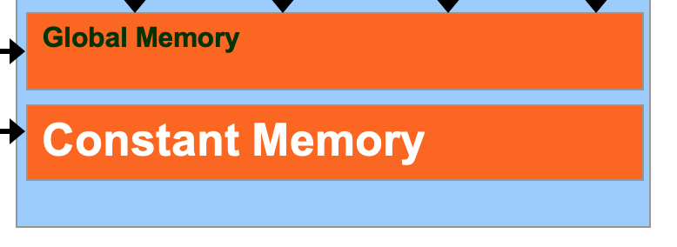
Memory Hierarchies
关于全局内存的常识：
如果我们总是需要访问全局内存（DRAM）来获取数据，那么 GPU 的执行速度将受到全局内存带宽的限制。
常量内存（Constant memory） 也位于 DRAM 中，
众所周知，访问 DRAM 是比较慢的.
我们如何从常量内存中受益呢?
One solution: Caches
Notes:
Use backpack analogy

Slide 16
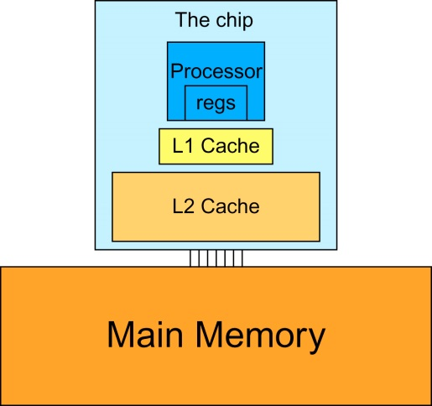
Memory Hierarchies
现代处理器缓存层级结构示意图:
Cache coherence mechanism
L1: 16~64k
L2: 128k~1M
X1
X10+
Notes:
Use backpack analogy

Slide 17
Cache
缓存是一个“数组”：
由多个缓存行（ cache lines ）组成，
通常，一个缓存行可以存储来自几个连续内存地址的数据 。
当从全局内存中请求数据时 :
包含所访问数据的整个缓存行会被加载到缓存中
从而减少对全局内存的请求次数；
缓存中的数据是全局内存中原始数据的“副本”;
Notes:
Cache is transparent vs scratchpad which isn’t

Slide 18
Caches - Cont’d
缓存的设计理念:
空间局部性（ Spatial locality ）:
储在连续内存位置的数据元素被连续访问
时间局部性（ Temporal locality ）:
相同的数据元素在短时间内被多次访问
空间局部性和时间局部性都能提高缓存的性能

Slide 19
Scratchpad vs. Cache
Scratchpad 便笺
CUDA 中的共享内存（shared memory）
另一种用于缓解主存竞争的临时存储类型。
从与处理器的距离来看，Scratchpad 与 L1 cache类似。
与缓存不同之处：
Scratchpad 并不一定持有（主存中也存在）的数据副本。
Scratchpad 需要显式的数据传输指令将数据传输到 Scratchpad 中的位置，而缓存则不需要。

Slide 20
Constant Cache in GPUs
对缓存数据的修改：
最终需要反射回（ reflected back ）全局内存中的原始数据。
这需要一套（复杂，用户不可见的）逻辑来跟踪修改状态.
Constant cache 常量缓存
是专门用于常量数据的特殊缓存：
在kernel执行期间，声明在常量内存中的数据不会被修改。
对于某些常见模式，常量缓存的访问吞吐量可以高于 L1 缓存。

Slide 21
How to Use Constant Memory
主机代码Host code中：
变量的声明、初始化
与其它需要拷贝到device的变量相同
使用 cudaMemcpyToSymbol(dest, src, size)
将变量复制到device内存中
这个复制函数告诉device：该变量不会被内核修改，并且可以安全地缓存.

Slide 22
A 1D Convolution Kernel using constant memory
__global__ void convolution_1D_basic_kernel( float *N, float *P, int Mask_Width, int Width) {
int i = blockIdx.x*blockDim.x + threadIdx.x;
float Pvalue = 0;
int N_start_point = i - (Mask_Width/2);
for (int j = 0; j < Mask_Width; j++) {
if (N_start_point + j >= 0 && N_start_point + j < Width) {
Pvalue += N[N_start_point + j] * M[j];
}
}
P[i] = Pvalue;
}

Slide 23
Host Code
// global variable, outside any kernel/function
__constant__ float Mc[MASK_WIDTH][MASK_WIDTH];
…
// allocate N, P, initialize N elements, copy N to Nd
Matrix M;
M = AllocateMatrix(MASK_WIDTH, MASK_WIDTH, 1);
// initialize M elements
….
cudaMemcpyToSymbol(Mc, M.elements,
MASK_WIDTH*MASK_WIDTH*sizeof(float));
ConvolutionKernel<<<dimGrid, dimBlock>>>(Nd, Pd);

Slide 24
Content
Convolution
An important parallel computation pattern
Taking advance of
Constant memory and caching
Tiled 1D convolution algorithms
Addressing memory bandwidth issue in accessing N
Algorithms and analysis
Tiled 2D convolution with halo cells
Algorithms and analysis

Slide 25
Tiled 1D Convolution Basic Idea
P
0
1
2
3
4
5
6
7
8
9
10
11
12
13
14
15
N
0
1
2
3
4
5
6
7
8
9
10
11
12
13
14
15
N
4 threads per block
Mask_Width = 5
Tile 0
ghost
0
1
2
3
4
5
Tile 1
2
3
4
5
6
7
8
9
halo
Tile 2
6
7
8
9
10
11
12
13
Tile 3
10
11
12
13
14
15
ghost
halo

Slide 26
Loading the left halo
n = 2
N
0
1
2
3
4
5
6
7
8
9
10
11
12
13
14
15
halo_index_left = 2
N_ds
2
3
4
5
6
7
8
9
Previous tile
int n = Mask_Width/2;
int halo_index_left = (blockIdx.x - 1)*blockDim.x + threadIdx.x;
if (threadIdx.x >= blockDim.x - n) {
N_ds[threadIdx.x - (blockDim.x - n)] =
(halo_index_left < 0) ? 0 : N[halo_index_left];
}
Last n

Slide 27
Loading the internal elements
n = 2
N
0
1
2
3
4
5
6
7
8
9
10
11
12
13
14
15
halo = 2
N_ds
2
3
4
5
6
7
8
9
N_ds[n + threadIdx.x] = N[blockIdx.x*blockDim.x + threadIdx.x];
Shift n, number of left halo

Slide 28
Loading the right halo
n = 2
N
0
1
2
3
4
5
6
7
8
9
10
11
12
13
14
15
N_ds
2
3
4
5
6
7
8
9
Next tile
int halo_index_right = (blockIdx.x+1)*blockDim.x + threadIdx.x;
if (threadIdx.x < n) {
N_ds[n + blockDim.x + threadIdx.x] =
(halo_index_right >= Width) ? 0 : N[halo_index_right];
}

Slide 29
__global__ void convolution_1D_tiled_kernel(float *N, float *P, int Mask_Width,
int Width) {
int i = blockIdx.x*blockDim.x + threadIdx.x;
__shared__ float N_ds[TILE_SIZE + MAX_MASK_WIDTH - 1];
int n = Mask_Width/2;
int halo_index_left = (blockIdx.x - 1)*blockDim.x + threadIdx.x;
if (threadIdx.x >= blockDim.x - n) {
N_ds[threadIdx.x - (blockDim.x - n)] =
(halo_index_left < 0) ? 0 : N[halo_index_left];
}
N_ds[n + threadIdx.x] = N[blockIdx.x*blockDim.x + threadIdx.x];
int halo_index_right = (blockIdx.x + 1)*blockDim.x + threadIdx.x;
if (threadIdx.x < n) {
N_ds[n + blockDim.x + threadIdx.x] =
(halo_index_right >= Width) ? 0 : N[halo_index_right];
}
__syncthreads();
float Pvalue = 0;
for(int j = 0; j < Mask_Width; j++) {
Pvalue += N_ds[threadIdx.x + j]*M[j];
}
P[i] = Pvalue;
}

Slide 30
Shared Memory Data Reuse
N_ds
2
3
4
5
6
7
8
9
Mask_Width is 5
Element 2 is used by thread 4 (1X)
Element 3 is used by threads 4, 5 (2X)
Element 4 is used by threads 4, 5, 6 (3X)
Element 5 is used by threads 4, 5, 6, 7 (4X)
Element 6 is used by threads 4, 5, 6, 7 (4X)
Element 7 is used by threads 5, 6, 7 (3X)
Element 8 is used by threads 6, 7 (2X)
Element 9 is used by thread 7 (1X)

Slide 31
Shared Memory Data Reuse
N
0
0
N[0]
N[1]
N[2]
N[3]
N[4]
N[5]
N[6]
0
0
P[0]
P[1]
P[2]
P[3]
P[4]
P[5]
P[6]

Slide 32
A Small 1D Example TILE_SIZE = 8, Mask_Width=5
N_ds
6
7
8
9
10
11
12
13
14
15
16
17
Mask_Width is 5
P
8
9
10
11
12
13
14
15
output and input tiles for block 1
因为 Mask_Width = 5,
每个线程块需要载入8+5-1 = 12 个元素
12 memory loads

Slide 33
Each output P element uses 5 N elements (in N_ds)
N_ds
6
7
8
9
10
11
12
13
14
15
16
17
Mask_Width is 5
P
8
9
10
11
12
13
14
15
P[8] uses N[6], N[7], N[8], N[9], N[10]
P[9] uses N[7], N[8], N[9], N[10], N[11]
P[10] uses N[8], N[9], N[10], N[11], N[12]
…
P[14] uses N[12], N[13], N[14], N[15],N[16]
P[15] uses N[13], N[14], N[15], N[16], N[17]
对于输出tile来说，总共使用 8 * 5 个N中的元素

Slide 34
一种简单的计算分块效益的方法
内部分片（internal tiles）:
共载入元素 (8+5-1)=12
8*5=40次全局global内存读取被shared 内存取代
带宽使用减少 40/12=3.3
边界分片（boundary tile ）:
(8+(5-1)/2)=10 个元素载入
global内存读取 40-3= 37次

Slide 35
In General for 1D, internal tiles
更一般的情况下， 对(TILE_SIZE+Mask_Width-1)个N中的元素，总共的全局内存读取次数可计算如下：
1 + 2 + … + Mask_Width-1+ Mask_Width * (TILE_SIZE -Mask_Width+1) + Mask_Width-1+… + 2 + 1
= ((Mask_Width-1) *Mask_Width)/2+ Mask_Width*(TILE_SIZE-Mask_Width+1) + ((Mask_Width-1) *Mask_Width)/2
= (Mask_Width-1) *Mask_Width+ Mask_Width*(TILE_SIZE-Mask_Width+1)
= Mask_Width*(TILE_SIZE)

Slide 36
In General, for 1D convolution kernel
内部线程块，全局内存和分块后使用共享内存的读取次数之比:
边界线程块:
大多数情况下，blockDim.x 远比n要大，因此有
(blockDim.x*(2n+1)) / (blockDim.x+2n)
(blockDim.x*(2n+1)–n(n+1)/2) / (blockDim.x+n)
(blockDim.x*(2n+1)/ blockDim.x
= 2n+1
= Mask_Width

Slide 37
Bandwidth Reduction for 1D
The reduction is
Mask_Width * (TILE_SIZE)/(TILE_SIZE+Mask_Width-1)
TILE_SIZE | 16 | 32 | 64 | 128 | 256
Reduction Mask_Width = 5 | 4.0 | 4.4 | 4.7 | 4.9 | 4.9
Reduction Mask_Width = 9 | 6.0 | 7.2 | 8.0 | 8.5 | 8.7

Slide 38
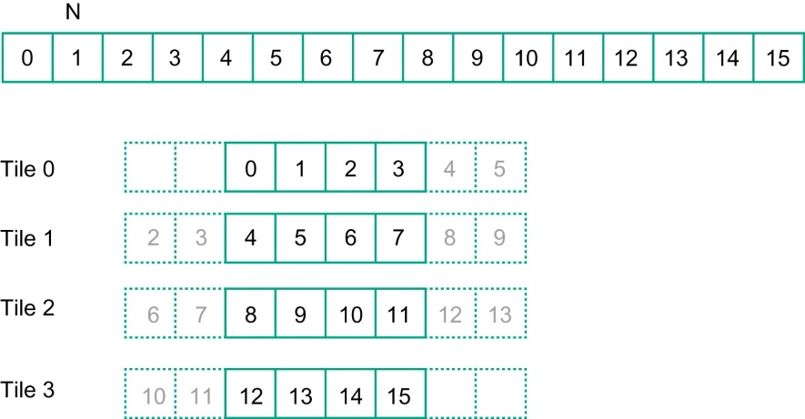
Simpler Tiled 1D convolution
利用通用缓存:
Modern GPU like Fermi has L1 and L2 caches:
L1 is private to each SM
L2 is shared among all SMs
线程块可以利用其halo cells可能存在于 L2 缓存这一事实。
因此，更简单的实现，仅将每个分块的内部元素加载到共享内存中即可.

Slide 39
__global__ void convolution_1D_tiled_cache_kernel(float *N, float *P,
int Mask_Width, int Width) {
int i = blockIdx.x*blockDim.x + threadIdx.x;
__shared__ float N_ds[TILE_SIZE];
N_ds[threadIdx.x] = N[i];
__syncthreads();
int This_tile_start_point = blockIdx.x * blockDim.x;
int Next_tile_start_point = (blockIdx.x + 1) * blockDim.x;
int N_start_point = i - (Mask_Width/2);
float Pvalue = 0;
for (int j = 0; j < Mask_Width; j ++) {
int N_index = N_start_point + j;
if (N_index >= 0 && N_index < Width) {
if ((N_index >= This_tile_start_point)
&& (N_index < Next_tile_start_point)) {
Pvalue += N_ds[threadIdx.x+j-(Mask_Width/2)]*M[j];
} else {
Pvalue += N[N_index] * M[j];
}
}
}
P[i] = Pvalue;
}

Slide 40
Content
Convolution
An important parallel computation pattern
Taking advance of
Constant memory and caching
Tiled 1D convolution algorithms
Addressing memory bandwidth issue in accessing N
Algorithms and analysis
Tiled 2D convolution with halo cells
Algorithms and analysis

Slide 41
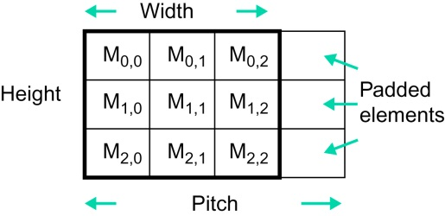
Padded format
图像有各种大小和形状，从文件读取到内存时以行主序格式存储。
如果图像的宽度（以字节为单位）不是 DRAM burst大小的倍数，则会导致 DRAM 带宽利用率低下.
Take 4 pixel as a burst, elements in row 1 need two DRAM bursts to load.

Slide 42
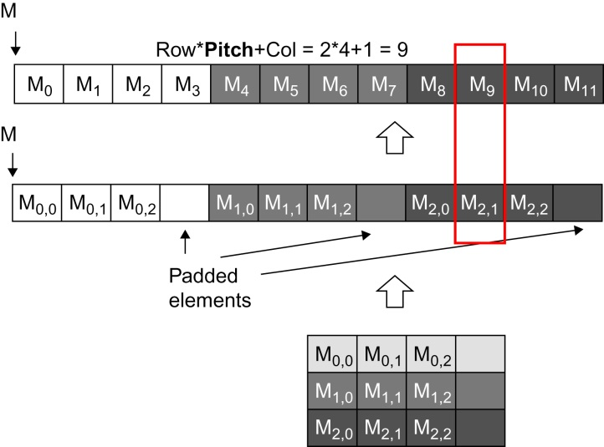
Padded format
//Image Matrix declaration
typedef struct {
int width;
int height;
int pitch;
int channels;
float* data;
} *wbImage_t;
Linearized 1D index = row * pitch + column

Slide 43
Input tiles need to be larger than output tiles.
3
4
5
6
7
2
3
4
5
6
1
2
3
4
5
2
3
5
6
7
Input Tile
0
1
1
3
1
Output Tile
采用tile策略，将输入分块加载到共享内存中。
3
4
5
6
7
2
3
4
5
6
1
2
3
4
5
2
3
5
6
7
0
1
1
3
1

Slide 44
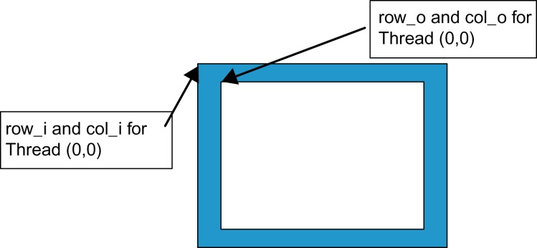

Input v.s. Output tile
int tx = threadIdx.x;
int ty = threadIdx.y;
int row_o = blockIdx.y * O_TILE_SIZE + ty;
int col_o = blockIdx.x * O_TILE_SIZE + tx;
int row_i = row_o - Mask_Width / 2;
int col_i = col_o - Mask_Width / 2;

Slide 45
Input v.s. Output tile
使用与输入分块（ input tile ）匹配的线程块
每个线程加载输入分块的一个元素
一些线程不参与计算输出
将会有“if”语句和控制流分歧（ control divergence ），以确保读取有效的元素

Slide 46
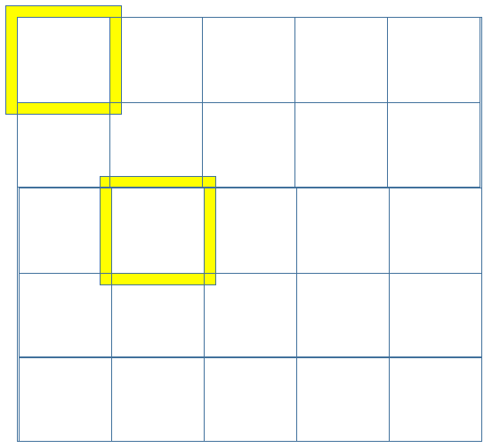
Load Input Tile
__shared__ float N_ds[TILE_SIZE + MAX_MASK_WIDTH-1] [TILE_SIZE + MAX_MASK_WIDTH-1]
if((row_i >= 0) && (row_i < height) &&
(col_i >= 0) && (col_i < width) ) {
N_ds[ty][tx] = data[row_i*pitch + col_i];
}
else{
N_ds[ty][tx] = 0.0f;
}
Threads that loads halos outside N should return 0.0

Slide 47
Some threads do not participate in calculating output.
float output = 0;
if(ty < O_TILE_SIZE && tx < O_TILE_SIZE)
{
for(i = 0; i < MASK_WIDTH; i++) {
for(j = 0; j < MASK_WIDTH; j++) {
output += M[i][j] * N_ds[i+ty][j+tx];
}
}
if(row_o < height && col_o < width)
data[row_o * width + col_o] = output;
}

Slide 48
Analysis 2D Tile convolution
3
4
5
6
7
2
3
4
5
6
Mask_Width = 5
1
2
3
4
5
2
3
5
6
7
Input Tile
12X12
0
1
1
3
1
TILE_SIZE 8X8
Output Tile
3
4
5
6
7
2
3
4
5
6
1
2
3
4
5
2
3
5
6
7
0
1
1
3
1

Slide 49
A Simple Analysis
for a small 8X8 output tile example (Mask_Width =5)
总共12X12=144个 N中的元素需要加载到共享内存 shared memory
计算每个P中的元素需要读取25次 N 中的元素
也就是 8X8X25 = 1,600 次的全局内存读取被转换为共享内存读取
因此，读取次数减少 1,600/144 = 11X

Slide 50
In General
分片方法 Tiled :
(O_TILE_SIZE+Mask_Width-1)² 个N中元素需要被读入共享内存 shared memory
基本方法Basic:
计算每个P中元素需要读取 Mask_Width² 个N中元素
总共O_TILE_SIZE² * Mask_Width² 次全局内存读取
The reduction is
O_TILE_SIZE² * Mask_Width² / (O_TILE_SIZE+Mask_Width-1)²

Slide 51
Bandwidth Reduction for 2D
The reduction is
O_TILE_SIZE² * Mask_Width² / (O_TILE_SIZE+Mask_Width-1)²
TILE_SIZE | 8 | 16 | 32 | 64
Reduction Mask_Width = 5 | 11.1 | 16 | 19.7 | 22.1
Reduction Mask_Width = 9 | 20.3 | 36 | 51.8 | 64
Input size: 64+8 = 72;
Tile size: 72x72 = 5184 or 20,736 bytes, larger than shared memory available.
9x9 = 81

Slide 52
Summary
Taking advance of
Constant memory and caching
Tiled convolution algorithms
Addressing memory bandwidth issue in accessing N

Slide 53
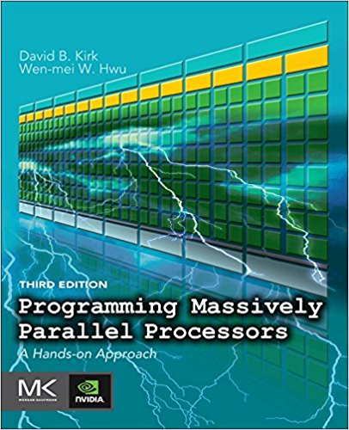
Reference
CUDA C Programming Guide,
https://docs.nvidia.com/cuda/cuda-c-programming-guide/index.html
Programming Massively Parallel Processors,
A Hands-on Approach
Third Edition
Chapter 7

